Slide 1
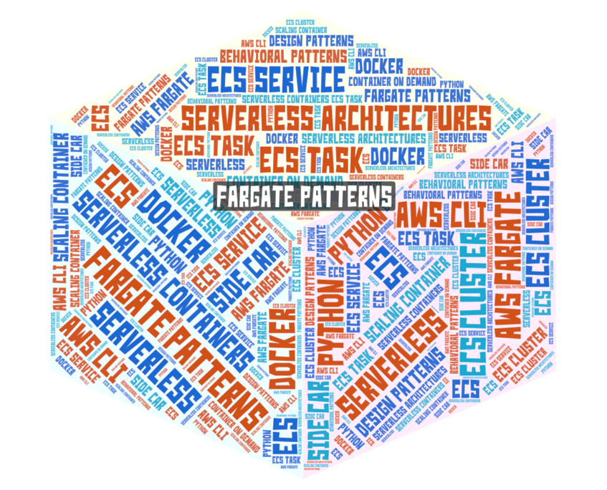
Fargate Patterns: or
Tom Thumb’s Journey to Fargate on a few Pennies
Srini Karlekar
Director & Distinguished Engineer, Finance Tech, Capital One
Presentation can be found at: http://bit.ly/fppresentation
Write-up: http://bit.ly/fargate-patterns-blog
Git: http://bit.ly/fargatepatterns

Slide 2
Description
AWS Fargate is the Uber* of container service allowing engineers to hail a container by specifying their compute and memory needs. By providing an incredible on-demand flexibility and removing the burden of resource provisioning just as Lambda did years ago to servers, Fargate is disrupting the container management technology.
In this presentation, we will explore three design patterns viz., the Container-on-Demand, Scaling-Container and Sidecar-Assembly patterns that allows Fargate to be used just like Lambdas for heavy on-demand tasks where Lambda is not suitable, or allow you to run containers traditionally but without having to manage infrastructure. Additionally, we will explore how to attach sidecar containers to a parent container to provide supporting features for the application.
Uber* - The transportation network company

Slide 3
Examples
We will use the Container-on-Demand pattern to build an on-demand video thumbnail service called Tom-thumb to generate thumbnail images from video files. With this pattern, you can spin the containers on demand and immediately decommission after the task is run.
We will use the Scaling-Container to build an auto-scaling service called Bean-counter that finds the value of the coins thrown on a table from an image. With this pattern, you will have a small footprint always running and scale up or down as the processing demands.
Later we will explore the Sidecar-Assembly pattern to deploy components of an application into a separate containers to provide isolation and encapsulation.
Go to http://bit.ly/fargatepatterns to see code examples and instructions on how build these services

Slide 4
What is AWS Fargate?
Put simply, AWS Fargate is a container management solution provided by AWS to run your containers without having to worry about managing a cluster of servers. You don't have to choose server types, upgrade or patch servers or optimize container packing on your clusters.
With Fargate, you package your application in containers, specify the CPU and memory requirements, define networking and IAM policies, and launch the application. Fargate takes care of provisioning enough compute resources for your containers to scale out or scale them in when they are not utilized.
If you are used to traditional container management, you will really appreciate Fargate allowing you to focus on the ‘Dev’ part of designing and building your applications and reduce the ‘Ops’ part of managing infrastructure from your ‘DevOps’ responsibilities.
Fargate is a serverless container management solution that runs containers without any EC2 instances

Slide 5
Fargate Use Cases
Workloads requiring low overhead - Managing a large cluster requires patching, upgrading, securing and rehydrating constantly. AWS takes care of this for the servers used by Fargate.
Small workloads, with occasional bursts - Workloads such as website traffic does not fully utilize the compute & memory you pay for. With Fargate you can scale down to a minimum number of instances when utilization is low (such as night time) and scale up as needed during core business hours.
Tiny workloads - For proof-of-concepts and test environments, Fargate is a perfect choice to optimize utilization.
Batch workloads - Loads that are kicked-off on schedules or occasional asynchronous jobs that are event-driven will be a good fit for Fargate.
Large workloads with consistent demand throughout the day/night is still best suited for ECS EC2 or Kubernetes clusters as it can take advantage of reserved or spot instances.

Slide 6
Fargate – the Good, Bad & Ugly
Good & Bad: Pay-per-use - Unlike ECS or EKS, you only pay for the computing time and memory that you actually use but the average per-hour cost for running Fargate is more than the per-hour cost of running ECS or EKS. This could be detrimental if you require always-on containers.
Good: Low Complexity – Don’t have to deal with underlying infrastructure. Only focus on memory size, CPU capacity and network ports. Better Security – Don’t have to deal with securing clusters of servers. Only focus on security within the container, the roles required to run your app and ports that must be opened. Faster Development - problems of systems management are alleviated, developers spend less time on operational issues and focus on solving business problems. Scaling - scaling is taken care of by the provider seamlessly.
Bad: Limited Availability - While AWS is rolling out Fargate to as many regions as they can, it is not as available as Lambdas, ECS or EKS. As of April 2019, Fargate is not available in GovCloud, Sao Paulo, Paris, Stockholm, Japan, and China..

Slide 7
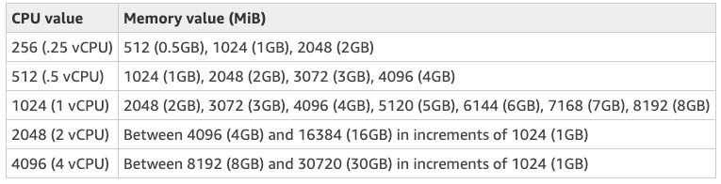
Fargate Pricing Model
With the ECS EC2 launch-type billing is based on the cost of the underlying EC2 instances. This allows you to optimize price by taking advantage of billing models such as spot instances (bid a low price for an instance), or reserved instances (get a flat discount for committing to an instance for a certain time period). However, it is your responsibility to make sure that your containers are densely packed onto instances to get the best use out of them, otherwise you will be wasting money.
With the ECS Fargate launch type billing is based on how many CPU cores, and gigabytes of memory your task requires, per second. You only ever pay for what your task uses, no more paying for EC2 capacity that goes unused. As of now, you can choose up to 48 combinations as seen below:
With its low maintenance overhead, rapid provisioning & pay-per-use,
Fargate can save you time, manpower, and money

Slide 8
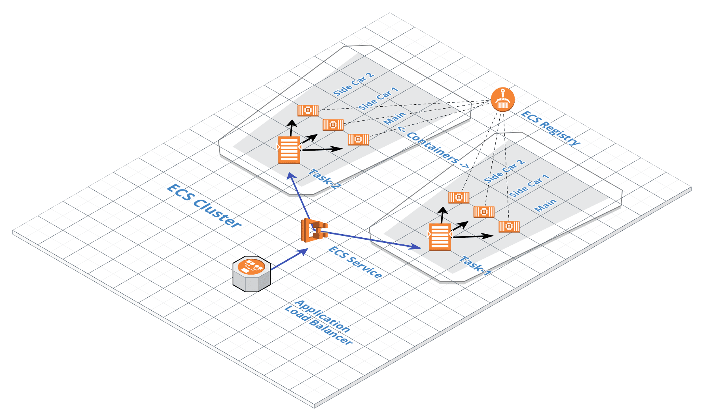
Components of AWS Fargate?
Container
Task
Service
Cluster
ALB

Slide 9
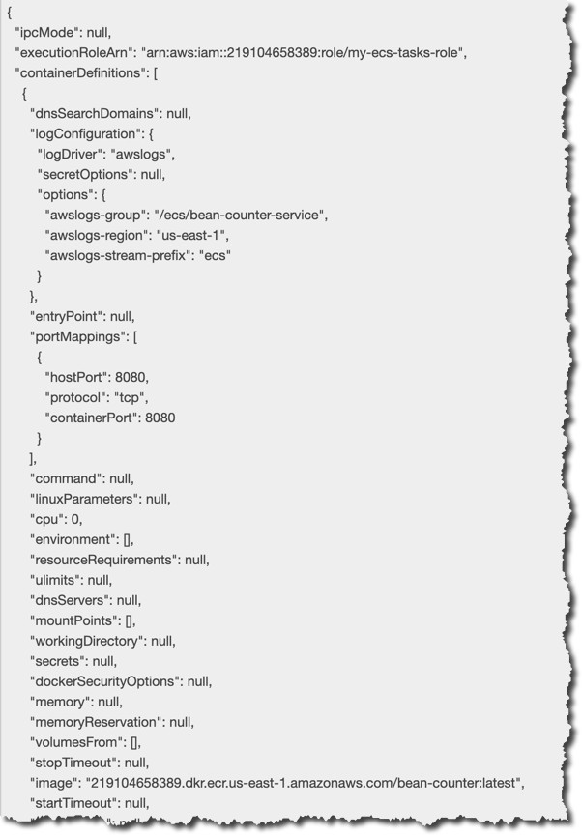
Fargate Components - Task
A Task is the smallest deployable unit on Fargate. A Task Definition is used as the blueprint for configuring tasks and each time you launch a task in Amazon ECS.
The Task Definition specifies which container repository and container image you want to use for running your Task. It also specifies the CPU, memory, the roles to use for executing the task. Fargate then knows which Docker image to use for containers, how many containers to use in the task and the resource allocation for each container.
One Task Definition creates several identical Tasks

Slide 10
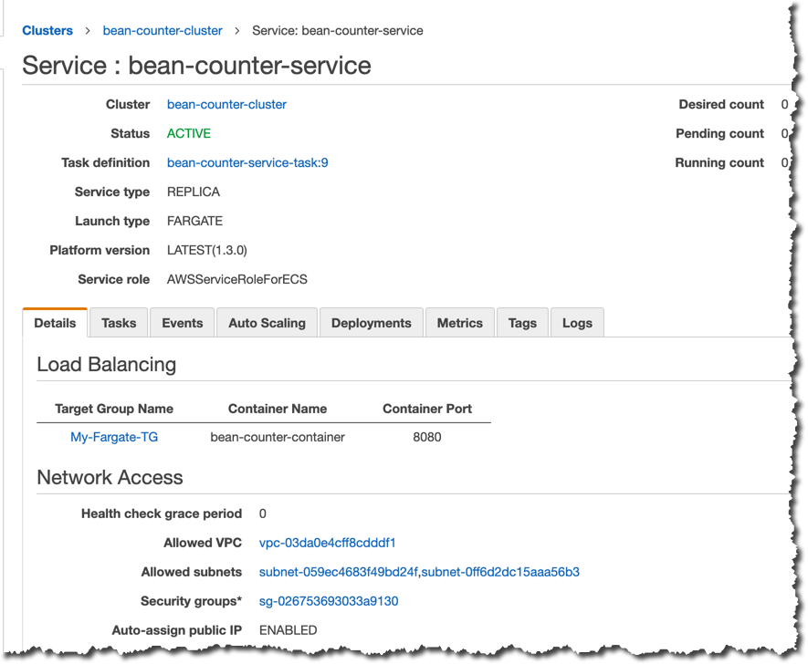
Fargate Components - Service
Fargate allows you to run and maintain a specified number of instances of a Task Definition simultaneously in an Amazon ECS cluster. This is called a Service.
If any of your tasks should fail or stop for any reason, the Amazon ECS service scheduler launches another instance of your task definition to replace it and maintain the desired count of tasks in the service depending on the scheduling strategy used.
In addition to maintaining the desired count of tasks in your service, you can optionally run your service behind a load balancer. The load balancer distributes traffic across the tasks that are associated with the service.

Slide 11
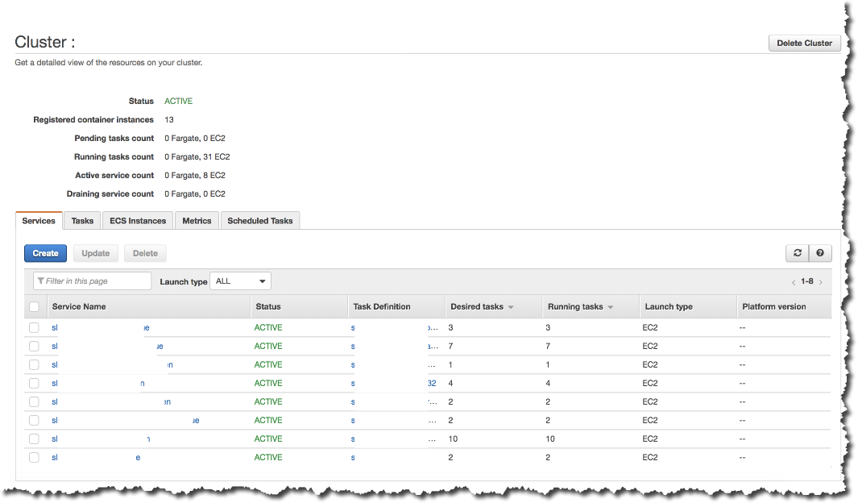
Fargate Components - Cluster
An Amazon ECS Cluster is a logical grouping of tasks or services. A Cluster can run many Services. If you have multiple services as part of your product, you can put several of them on one Cluster. This makes more efficient use of the resources available and minimizes setup time. Clusters are AWS region specific and can contain tasks using both the Fargate and EC2 launch types.
Container 1
Task 1
Container 2
Service A
Task 2
Container 1
Cluster 1
Container 3
Service B
Task 3
Container 4

Slide 12
Behavioral Design Patterns for AWS Fargate
Behavioral patterns provide a solution for the better interaction between components and foster loose coupling while providing the flexibility to extend these components easily and independent of each other.
While there are multiple container-related patterns, we will explore the following.
Container-on-Demand
Scaling-Container
Sidecar-Assembly

Slide 13
Container-on-Demand Pattern - Problem Definition
While Lambda allows you to build serverless microservices using small functions that react to events with fast development, easy deployment, auto-scaling, fault-tolerance and pay-per-use, it has many limitations. Chief among them is the time limitation and deployment size.
As a result, it is not possible to run large asynchronous workloads or long running processes on Lambda. Further, the resource limitation around the size of the software package restricts the type of workloads you can run on Lambda. For instance, if you have a machine learning model that requires the usage of large libraries such as Scikit, Numpy, etc, it is impossible to fit the software package in a Lambda deployment

Slide 14
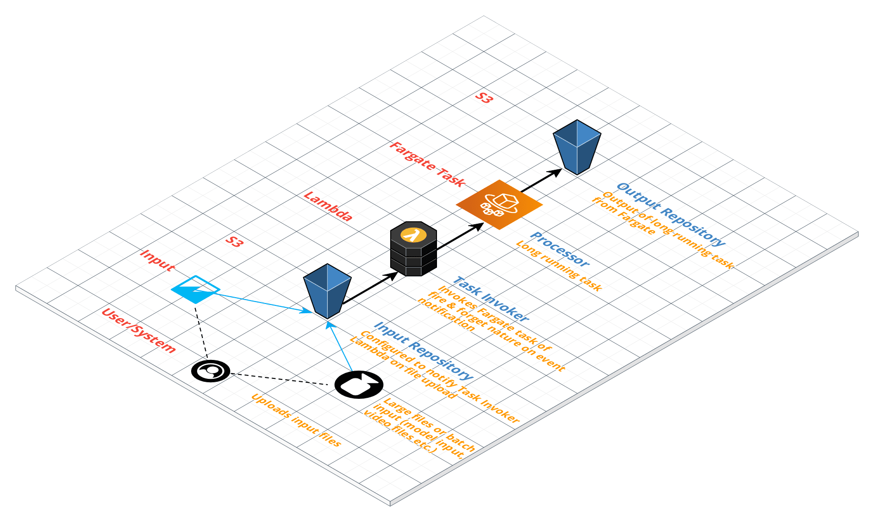
Container-on-Demand Pattern - Solution
Deploy your software package in a container as a Fargate Task. Invoke the task using a Lambda. The Fargate Task is started from a dormant state. Once the process is complete and the output is written to the output repository, the Task is automatically stopped. As a result of this, you pay only for the time the Task is running. Additionally, you can pre-configure the size of the task (vCPU, memory, environment variables to pass parameters to the job) or override it for every invocation.

Slide 15
Container-on-Demand Pattern - Components
Input Repository – The input for your Processor is stored here and should be reachable by the processor. This could be an S3-based object store or a database. Ideally, this repository should notify the task invoker when a new object is uploaded or updated.
Task Invoker – A short-running function that is used to invoke your Processor. This could be a Lambda function or synchronous service running as part of another larger process chain.
Processor – A long-running task that is the core of the pattern. It is invoked by the Task Invoker. This could be a Fargate Task that reads its input from the Input Repository, processes it and writes back the output to the Output Repository. The Fargate task can be configured to use one or more containers (with a maximum of 10).
Output Repository – Results of the Fargate Task are stored here. Again, this could be an S3 store or a database and could be optionally configured to emit events on inserts and updates.

Slide 16
Container-on-Demand Pattern - Example
Tom Thumb - A Video Thumbnail Generator Task
Tom Thumb is a video thumbnail generator task. It is implemented following the Container-on-Demand pattern.
In a typical usage, an user uploads a video file to a S3 bucket. A trigger is set on the S3 bucket to notify a Lambda function in the event of a file upload to the video folder in the bucket. The Lambda is deployed with a Python code to extract the name of the video file from the Lambda notification event and invoke a Fargate task. The Fargate task consists of one container that uses ffmpeg application to decode the video and freeze an image at a given position in the video. The frozen image is written to a pre-configured folder in a S3 bucket.
See the http://bit.ly/tom-thumb subproject in http://bit.ly/fargatepatterns

Slide 17
Scaling Container Pattern - Problem Definition
While the Container-on-Demand pattern helps overcome the time limitation issue for asynchronous jobs, for synchronous web services that execute within these limits, the main limitations are the size of the deployment package supported in Lambda.
How do we run synchronous services where the size of the deployment package exceeds the Lambda limits?
While Lambda Layers mitigate some of this issue by allowing artifacts to be shared between Lambdas, it introduces it own set of issues, especially around testing Lambdas locally and layers still count towards the 250MB hard limit on the unzipped deployment package size.
What if you want to run always-on services that can scale on-demand?
Note that, the Container-on-Demand pattern spins up a task to execute the job and spins it down. For asynchronous workloads, the time taken to spin-up is not an issue. But for synchronous web services, this time spent spinning up is dear.

Slide 18
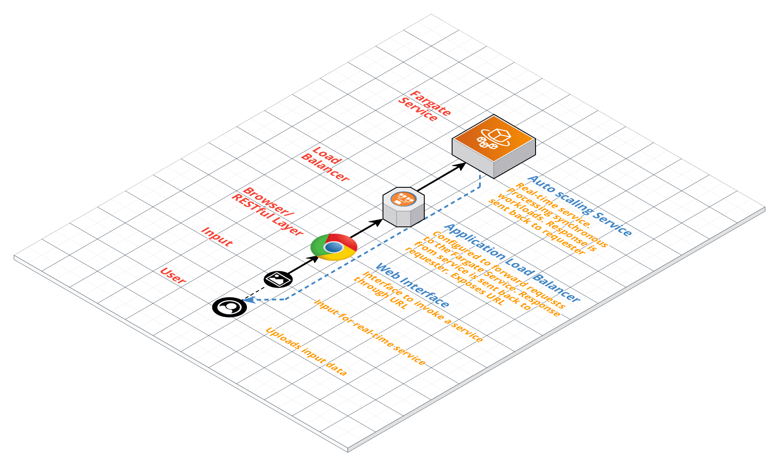
Scaling Container Pattern - Solution
Deploy your software using a Fargate Service fronted by an Application Load Balancer.
Deploy your service in a Fargate Task
Open ports for two-way communication in the Task and Container
Create an ECS Service to wrap around the Fargate Task.
Attach an Application Load Balancer in front of the Fargate Service.
Register an auto-scaling target with rules on when to scale out your service and when to scale it in.

Slide 19
Scaling Container Pattern - Components
Fargate Task - A Fargate task that has its ports open for two-way communication using one or more containers (within a maximum limit of ten containers).
ECS Service - An ECS service that uses the Fargate Task from above identifying the desired count of tasks that must be run at any given time.
Application Load Balancer - An Application Load Balancer with a listener to forward requests to the ECS Service.
API Gateway - An optional API gateway configured to forward requests to the application load balancer.
Web Interface - An optional browser-based interface for allowing users to post requests to the service. This could be a simple HTML form.
You can optionally add service discovery with Route 53

Slide 20
Scaling Container Pattern - Example
Bean-counter - A Coin-counter Service
Bean Counter is a coin counter service. It will analyze an image of coins and return the total value of the coins in the image. It works only on US Mint issued coined and does not recognize any denomination above a quarter dollar coin. It also assumes that the picture contains a quarter. The quarter is used to calibrate the size of the coins. It is implemented following the Scaling-Container pattern.
In typical usage, a user navigates to the URL of the ALB on the browser and enters the URL for the service along with the location of the image file containing the picture of the coins. The Bean-Counter service then invokes the Fargate Task and returns the response to the browser.
See the http://bit.ly/bean-counter subproject in http://bit.ly/fargatepatterns

Slide 21
Sidecar Assembly Pattern - Problem Definition
Services require orthogonal technical capabilities, such as monitoring, logging, configuration, and security services. While the components encapsulating these orthogonal capabilities can be integrated into the main service, it will leave the main service exposed to the vagaries of these components. For instance, they will not be well isolated, and an outage in one of these components can affect other components or the entire service. Also integrating them into one component means they must be implemented using the same language as the parent service. As a result, the component and the main service have close interdependence on each other.
One option is to deploy these orthogonal components as separate services allowing each component to have its own life-cycle and be built using different languages. While this gives more flexibility, deploying these features as separate services can add latency to the application.

Slide 22
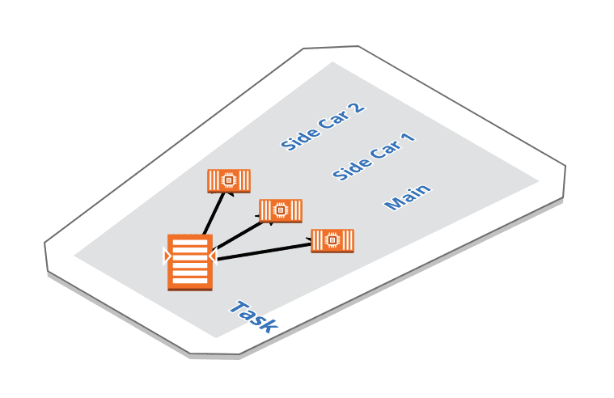
Scaling Container Pattern - Solution
Co-deploy the orthogonal components along with the main service by placing them in their own containers. Containers in a task are co-deployed together in the same host thereby not affecting the latency of the service significantly for the communication between them.
As a result of this co-deployment, the sidecar and the main service can access the same resources. This allows the sidecar to monitor system resources used by both the sidecar and the primary service.

Slide 23
Conclusion
Each application is unique and solving different needs based on business requirements. If the task of infrastructure management is too onerous and/or if you only want to pay for your computing time, then Fargate may be the right choice for you.
On the other hand, if you need greater control of the network resources or have large container workloads with consistent demand throughout the day, then it warrants maintaining a cluster of servers to run ECS or EKS. With the latter choice, you can use reserved or spot instances to offset your cost.

